Slide 1
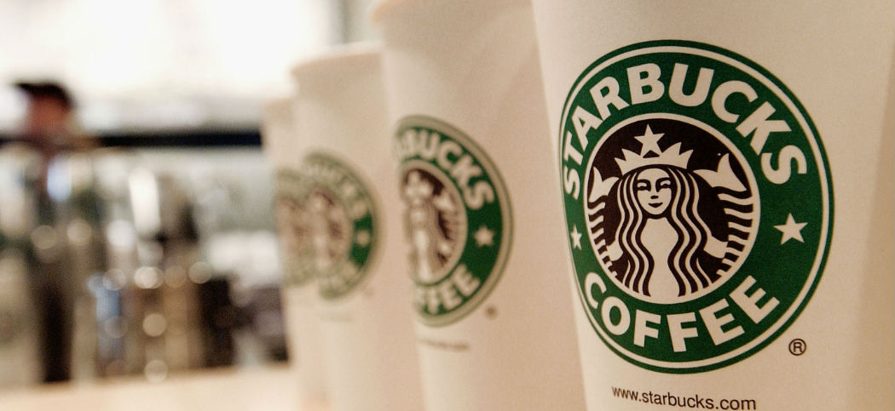

Calories in Cups: Examining Starbucks Drink Ingredients
This Photo by Unknown author is licensed under CC BY-NC-ND.

Slide 2
Agenda
Background Research
Exploring research questions
Conclusion
Dataset overview

Slide 3
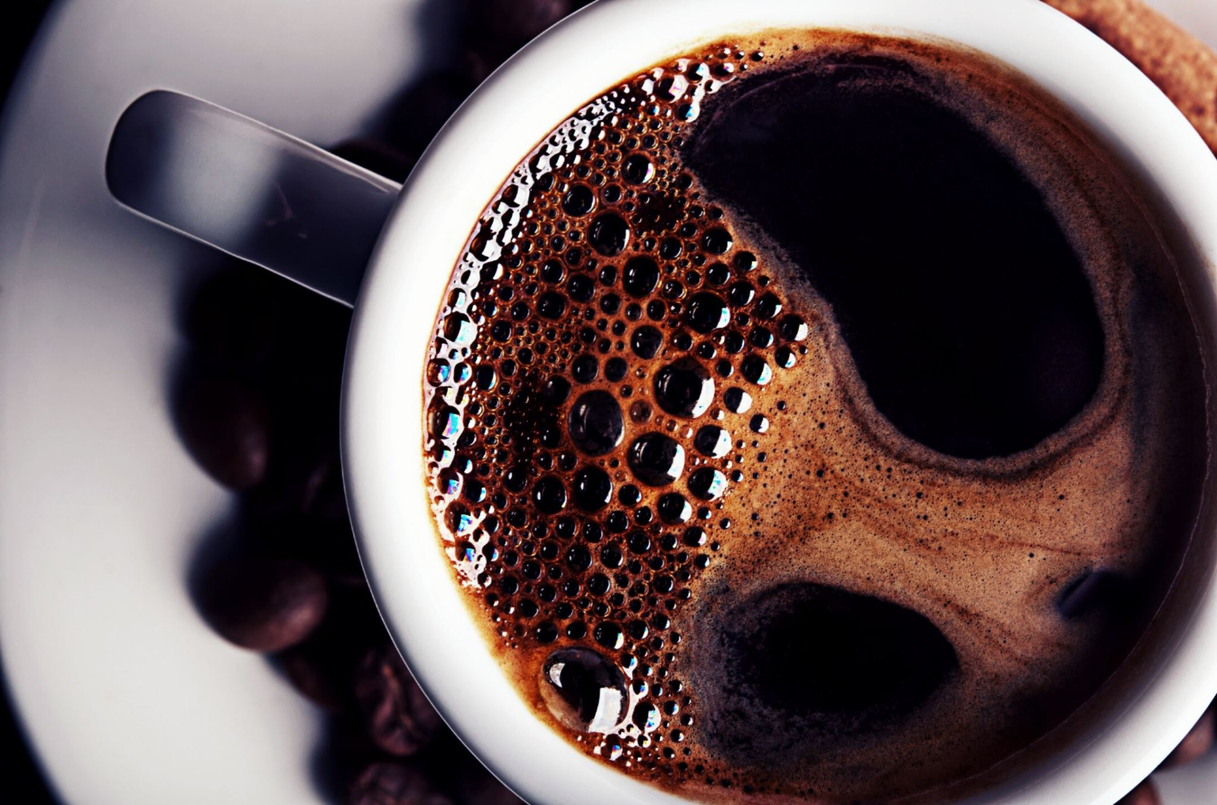
Background Research
According to Drive Research in January 2024 in the USA:
Nearly 3 in 4 Americans drink coffee every day (73%)
36% of people drink 3 to 5 cups of coffee a day
51% of people purchase coffee from a coffee shop at least once a week
25% of people like to sip on espresso martinis, a 79% increase from 2022
48% of people agree that drinking coffee benefits their health
48% of people report Starbucks coffee is their favorite brand, while 45% prefer Dunkin' coffee
Drive Research. "The National Coffee Survey: A Look at the Latest Coffee Consumption Trends." Drive Research Market Research Company Blog. October 13, 2021. Accessed March 25, 2024. https://www.driveresearch.com/market-research-company-blog/coffee-survey/.

Slide 4
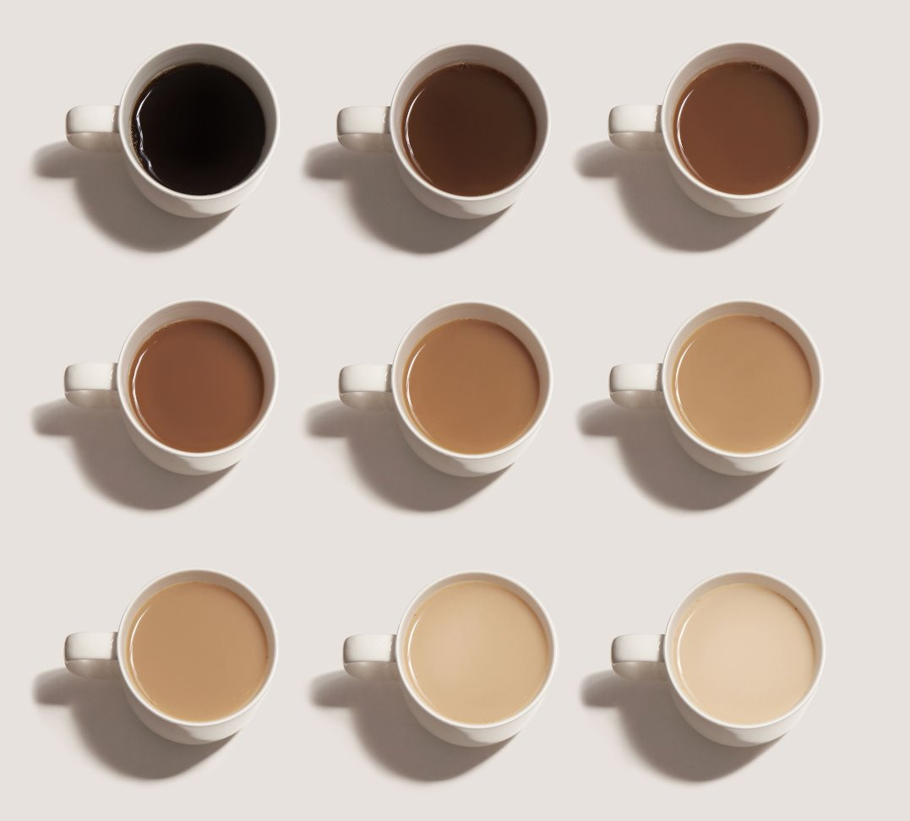
How to predict calories from ingredients and drink type?

Slide 5
Dataset
This dataset includes the nutritional information for Starbucks’ drink menu items. ​
Population: Starbucks drink menu​
Sample Size: 242 items​
Variables: ​
Source: Kaggle Dataset
Calories | Total Fat (g) | Sodium (mg) | Total Carbohydrates (g)
Cholesterol (mg) | Protein (g) | Vitamin A (% DV) | Vitamin C (% DV)
Calcium (% DV) | Beverage_category | Iron (% DV) | Caffeine (mg)

Slide 6
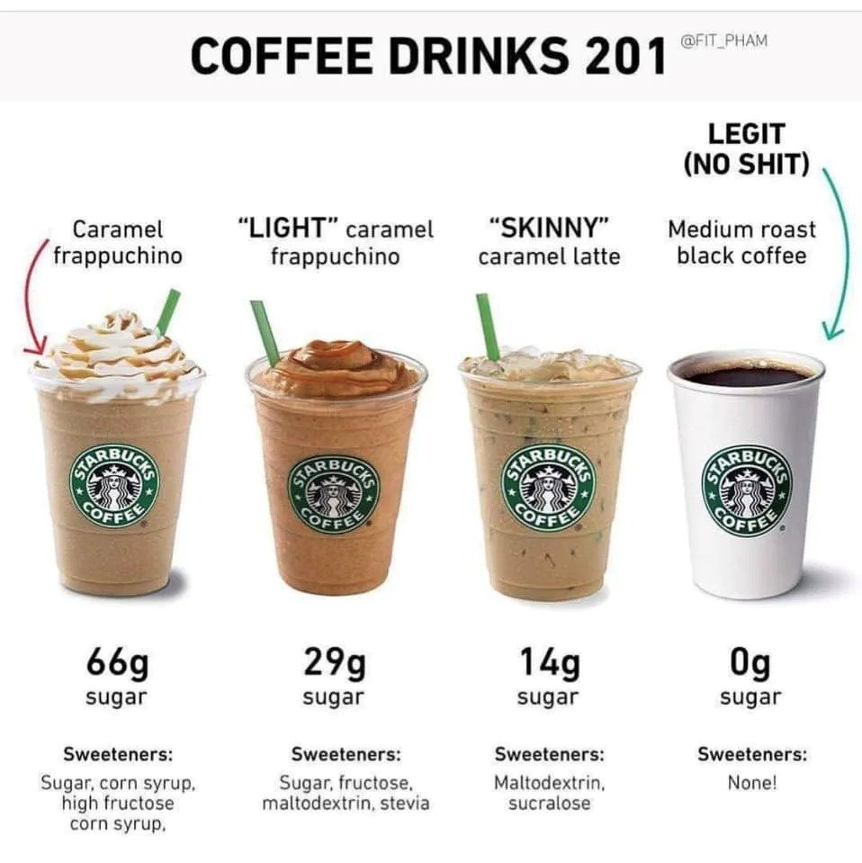
Drink Type Modification
Frappuccino:
Frappuccino® Blended Coffee
Frappuccino® Blended Crème
Frappuccino® Light Blended Coffee
Espresso:
Classic Espresso Drinks
Coffee
Signature Espresso Drinks
Non-Coffee:
Shaken Iced Beverages
Tazo® Tea Drinks
Smoothies

Slide 7
Analysis

Slide 8
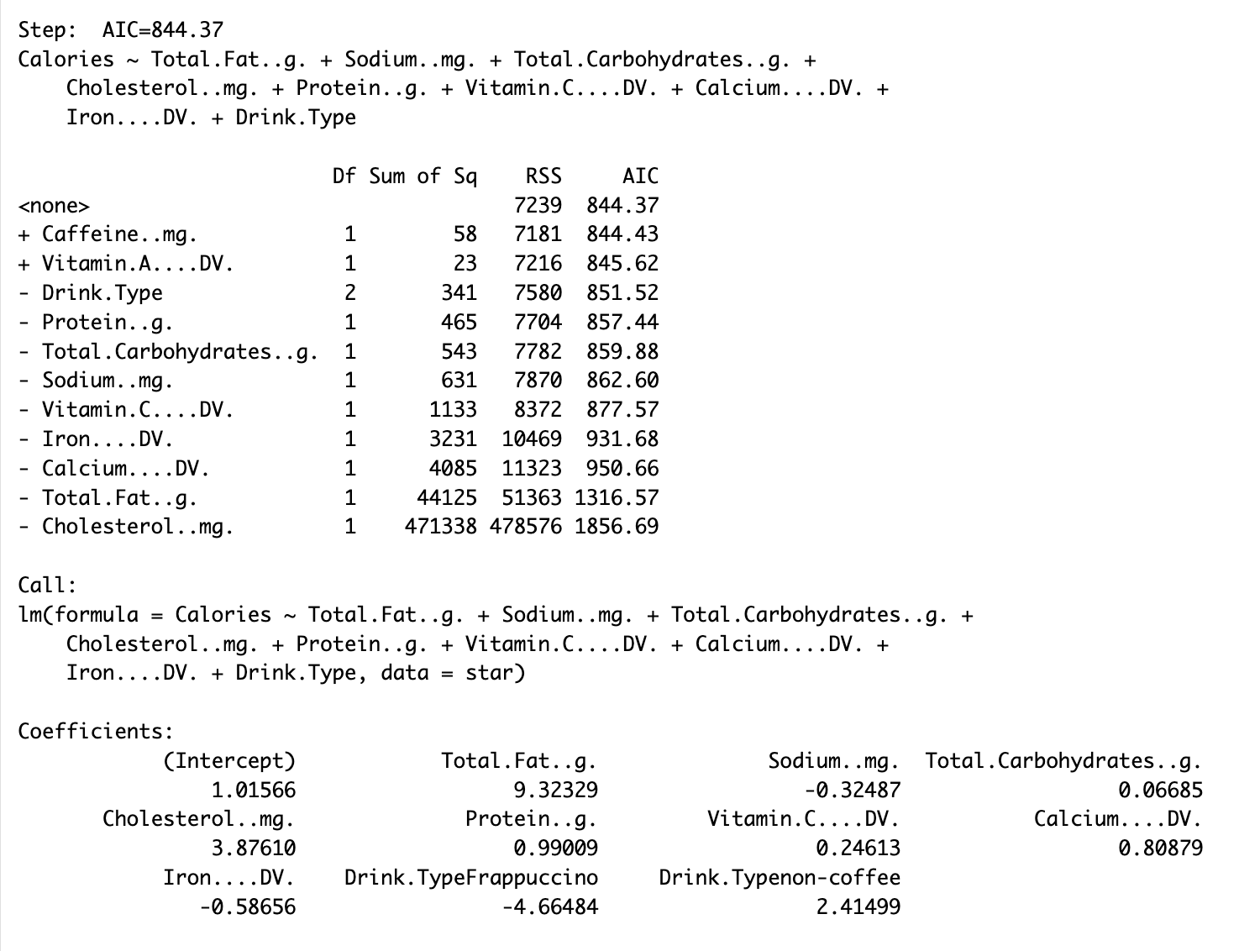
Model Selection
Model 1
Caffeine and Vitamin A were removed

Slide 9
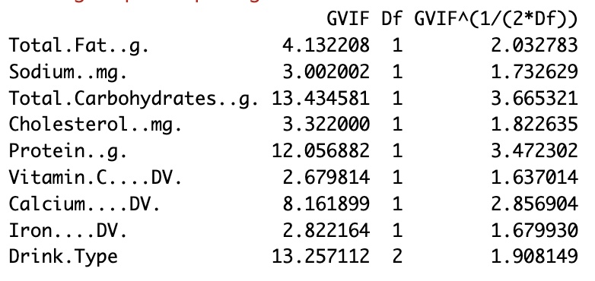
Multicollinearity Detected
Detected multicollinearity between several variables
Total Fat and Total Carbohydrates are essential to our model
=> Removed Protein and Calcium from the model

Slide 10
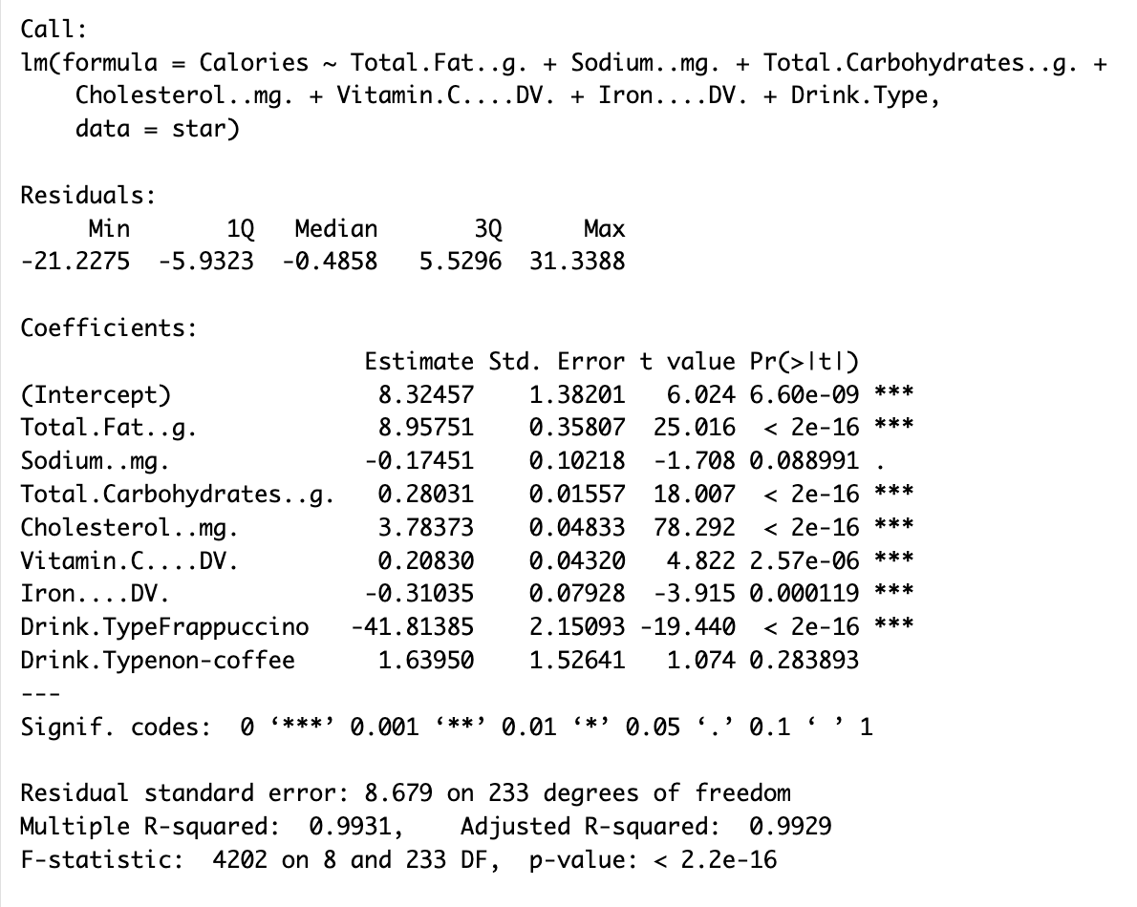
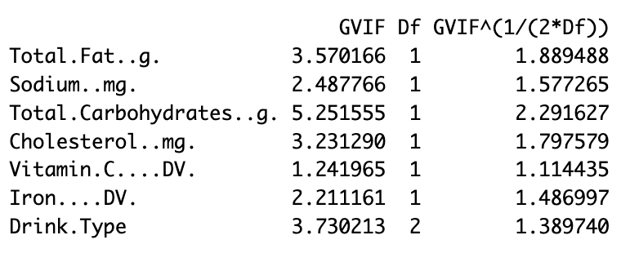
Model Selection cont.
Model 2: without Calcium and Protein
Comparing Model 1 and Model 2

Slide 11
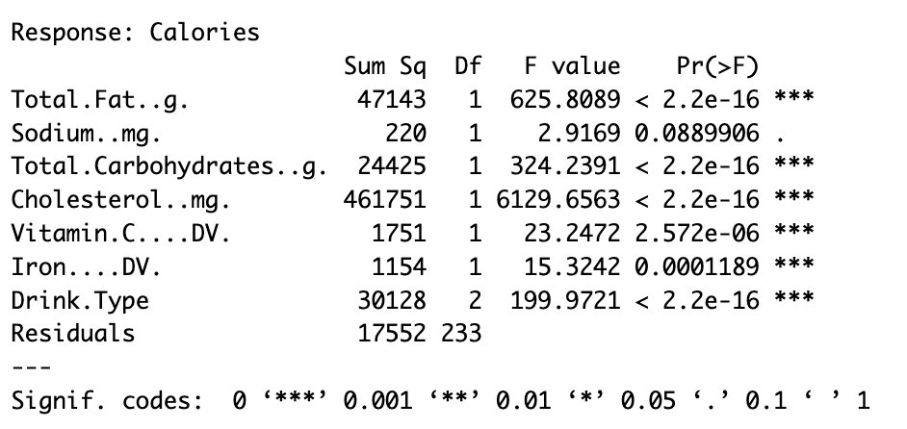
Model Selection cont.
ANOVA test on Model 2
Removed sodium as it’s not significant at ⍺ = 0.05 level

Slide 12
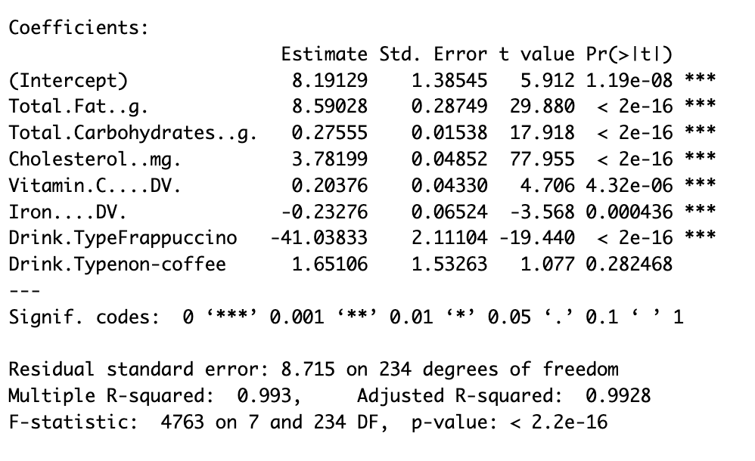
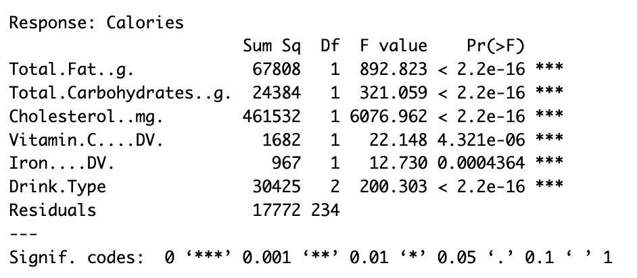
Model Selection cont.
Model 3: without sodium

Slide 13
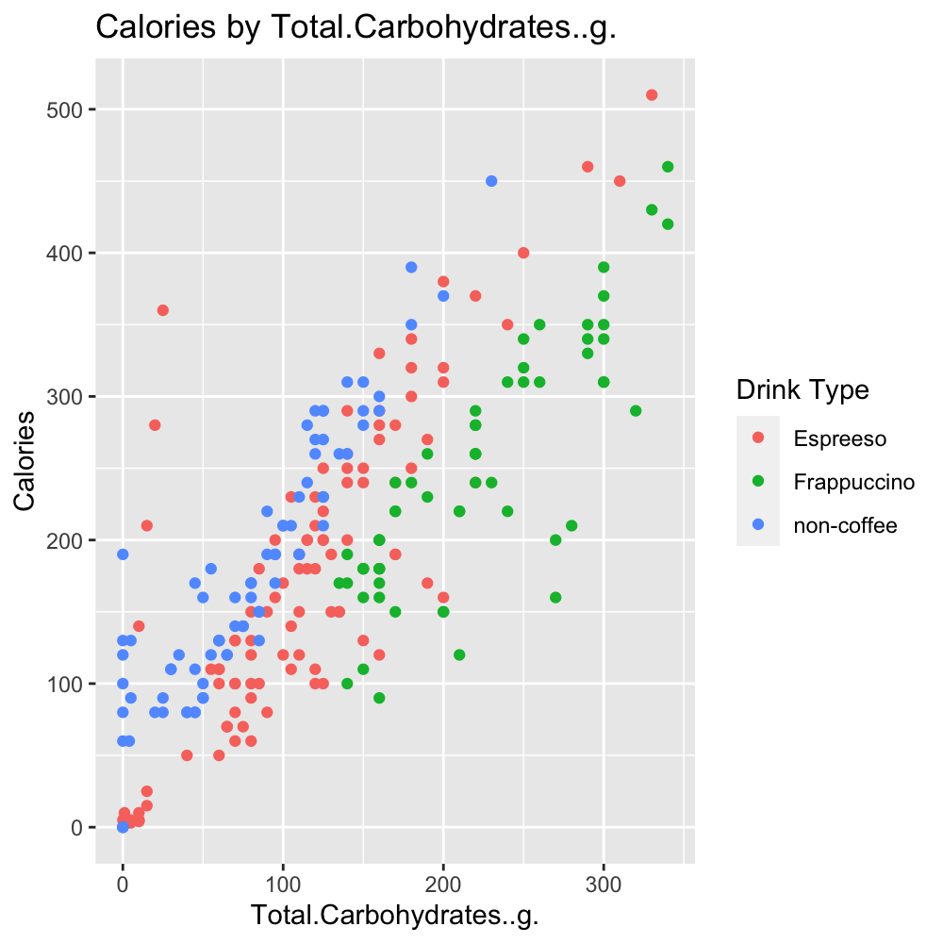
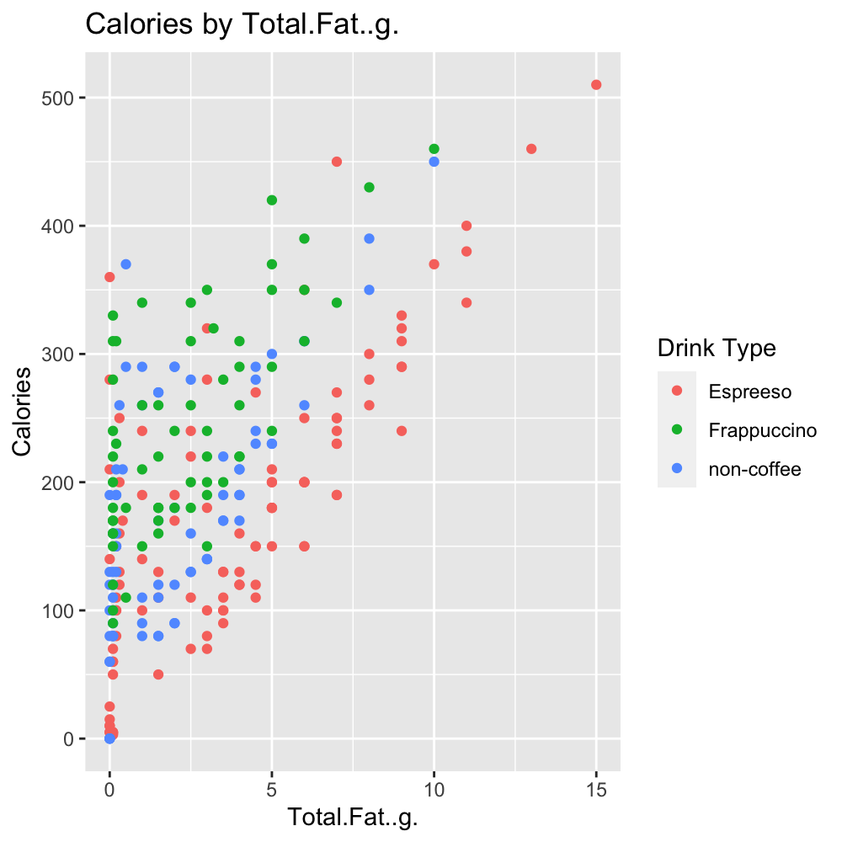
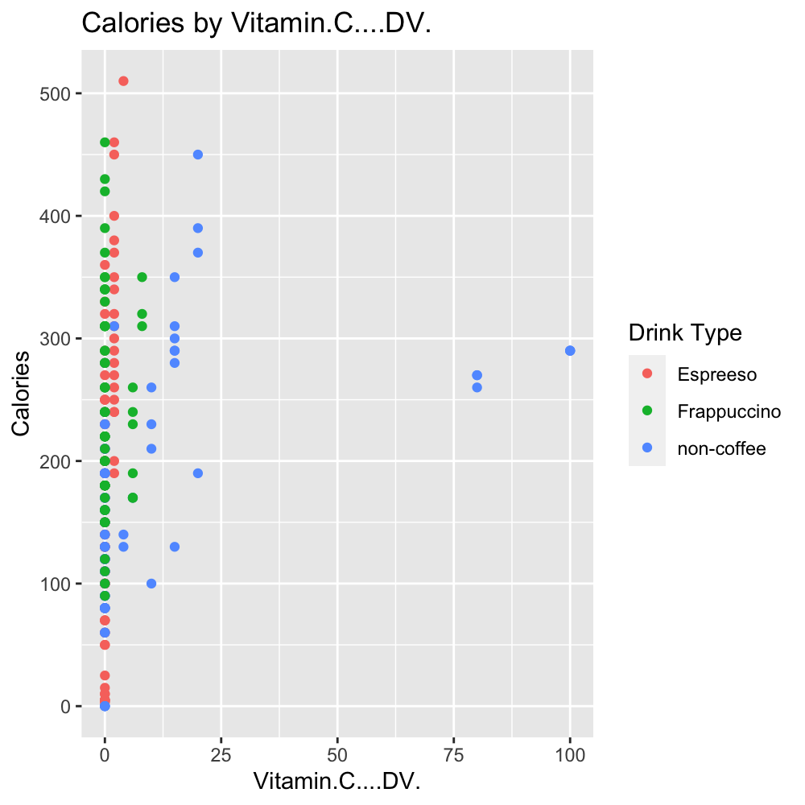
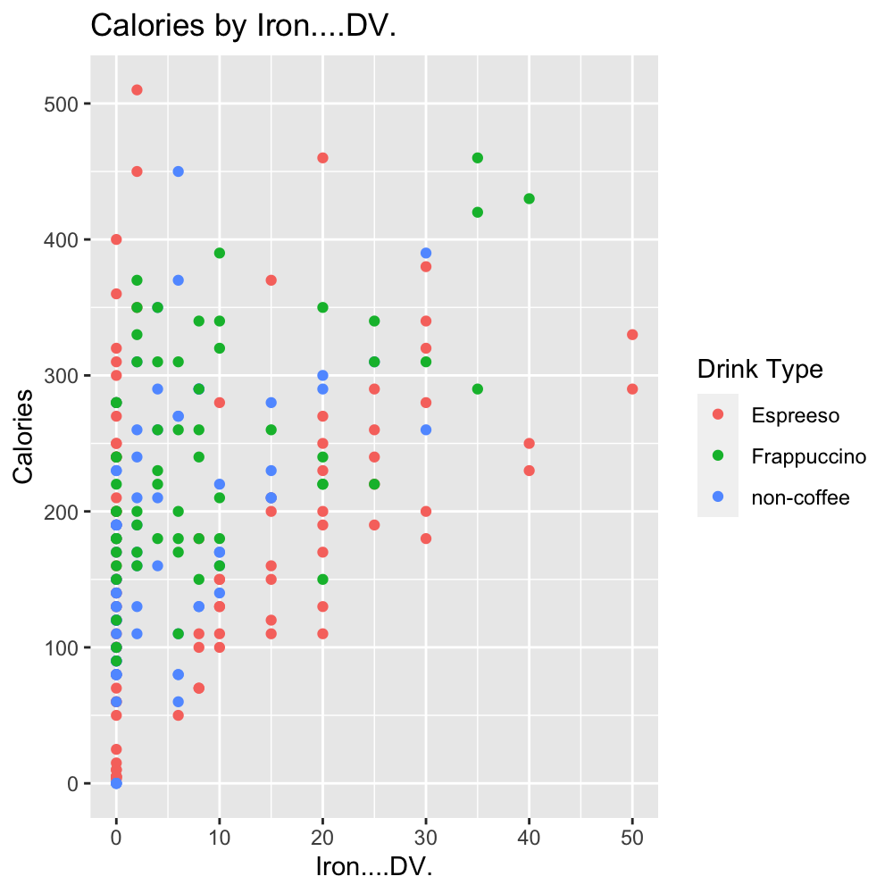
Interaction
● Espresso ● Frappuccino ● Non-Coffee

Slide 14
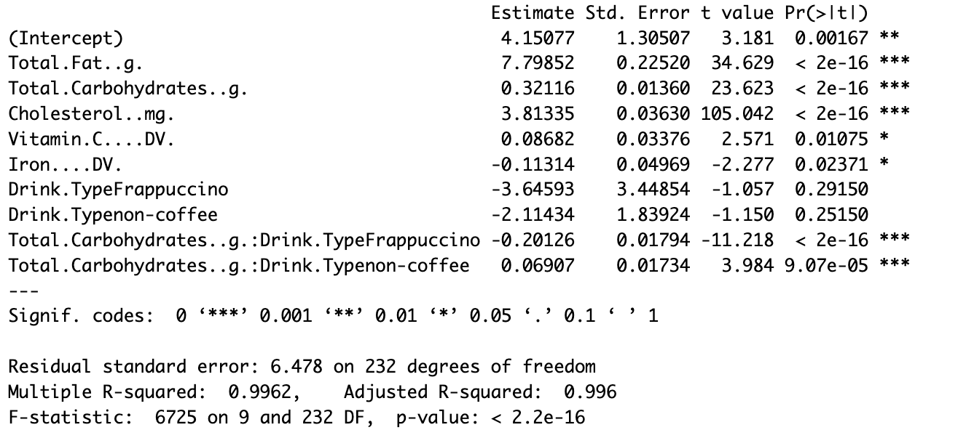
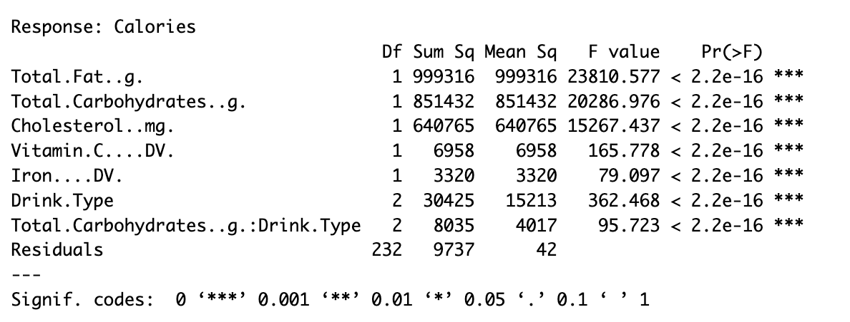
Model Selection cont.
Model 4: with interaction between Drink Type and Total Carbohydrate

Slide 15
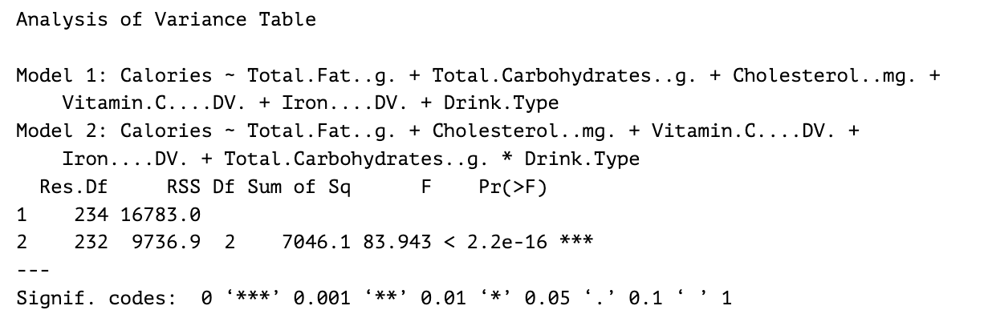
Model Selection cont.
H0: Model 3 is better
Ha: Model 4 is better (with interaction)
P-value = 2.2e-16
Model 4 with interaction between Drink Type and Total Carbohydrate is better.
However, R² adjusted only increased by 0.32%
Simple model is preferred. Stay with Model 3 as final model.

Slide 16

Model Selection Final: Model 3
Final model: Model 3
$Estimated Average Calories =\text{ 8.19}$
$+ 8.59\left(Total.Fat\right)$
$+ 0.28(Total.Carbohydrates)$
$+ 3.78\left(Cholesterol\right)$
$+ 0.20\left(Vitamin C\right)$
$− 0.23\left(Iron\right)$
$− 41.04\left(Frappuccino\right)$
$+1.65\left(NonCoffee\right)$

Slide 17
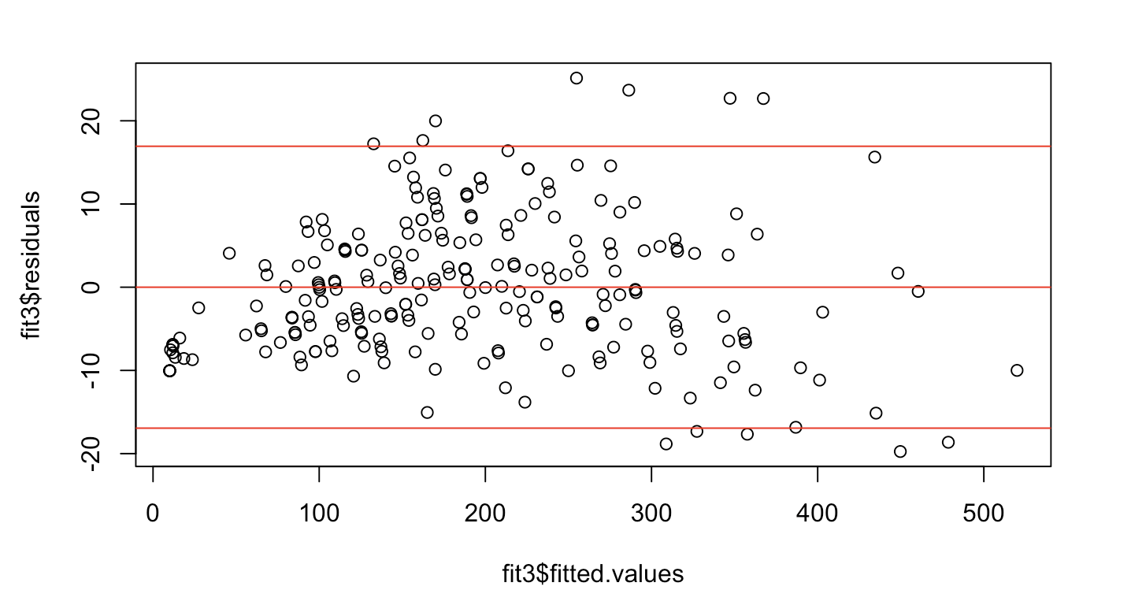
Residuals Analysis

Slide 18
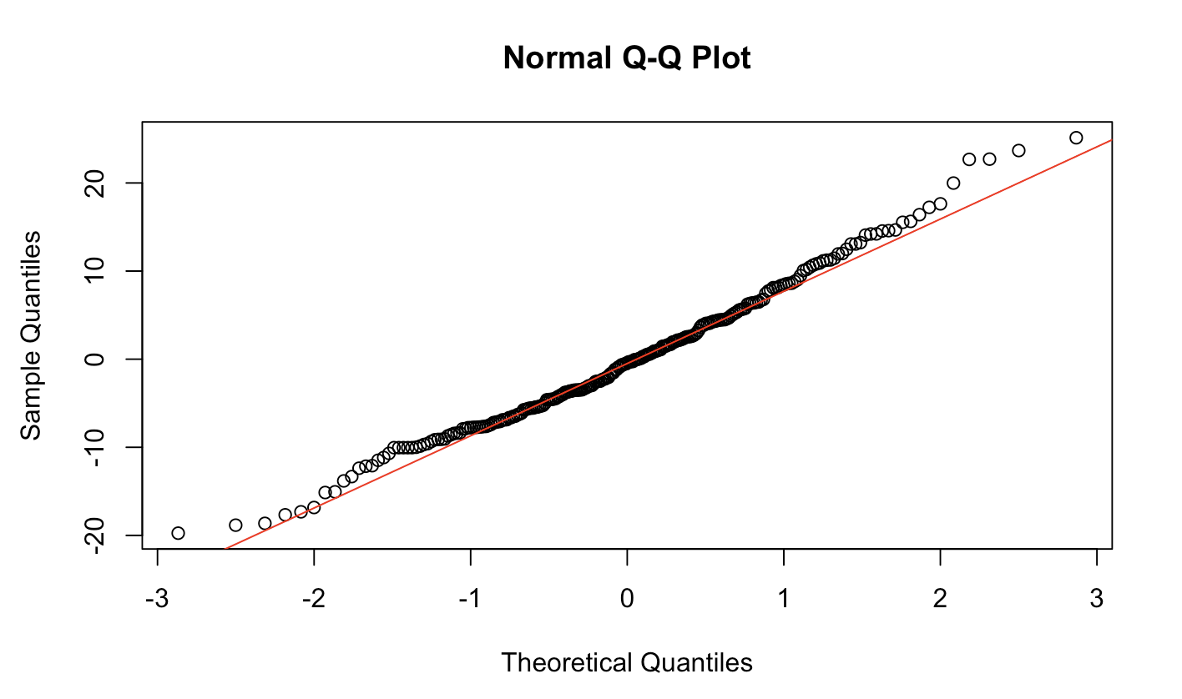
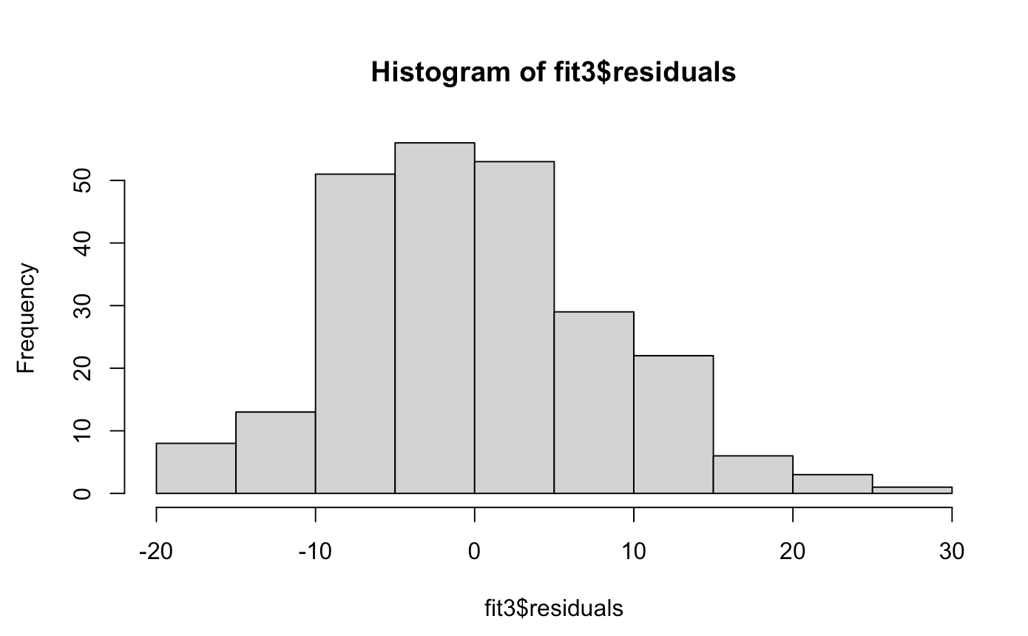

Slide 19
Conclusion
Total Fat, Total Carbohydrates, Cholesterol, Vitamin C, and Iron are all significant predictors of calorie content
Total Fat and Total Carbohydrates have positive coefficients, suggesting that higher levels of these nutrients lead to increased calorie content
Iron has a negative coefficient, implying that a higher level of Iron is associated with lower calorie content
Frappuccino has a negative coefficient when compared to Espresso, suggesting that Frappuccino drinks tend to have fewer calories than Espresso

Slide 20
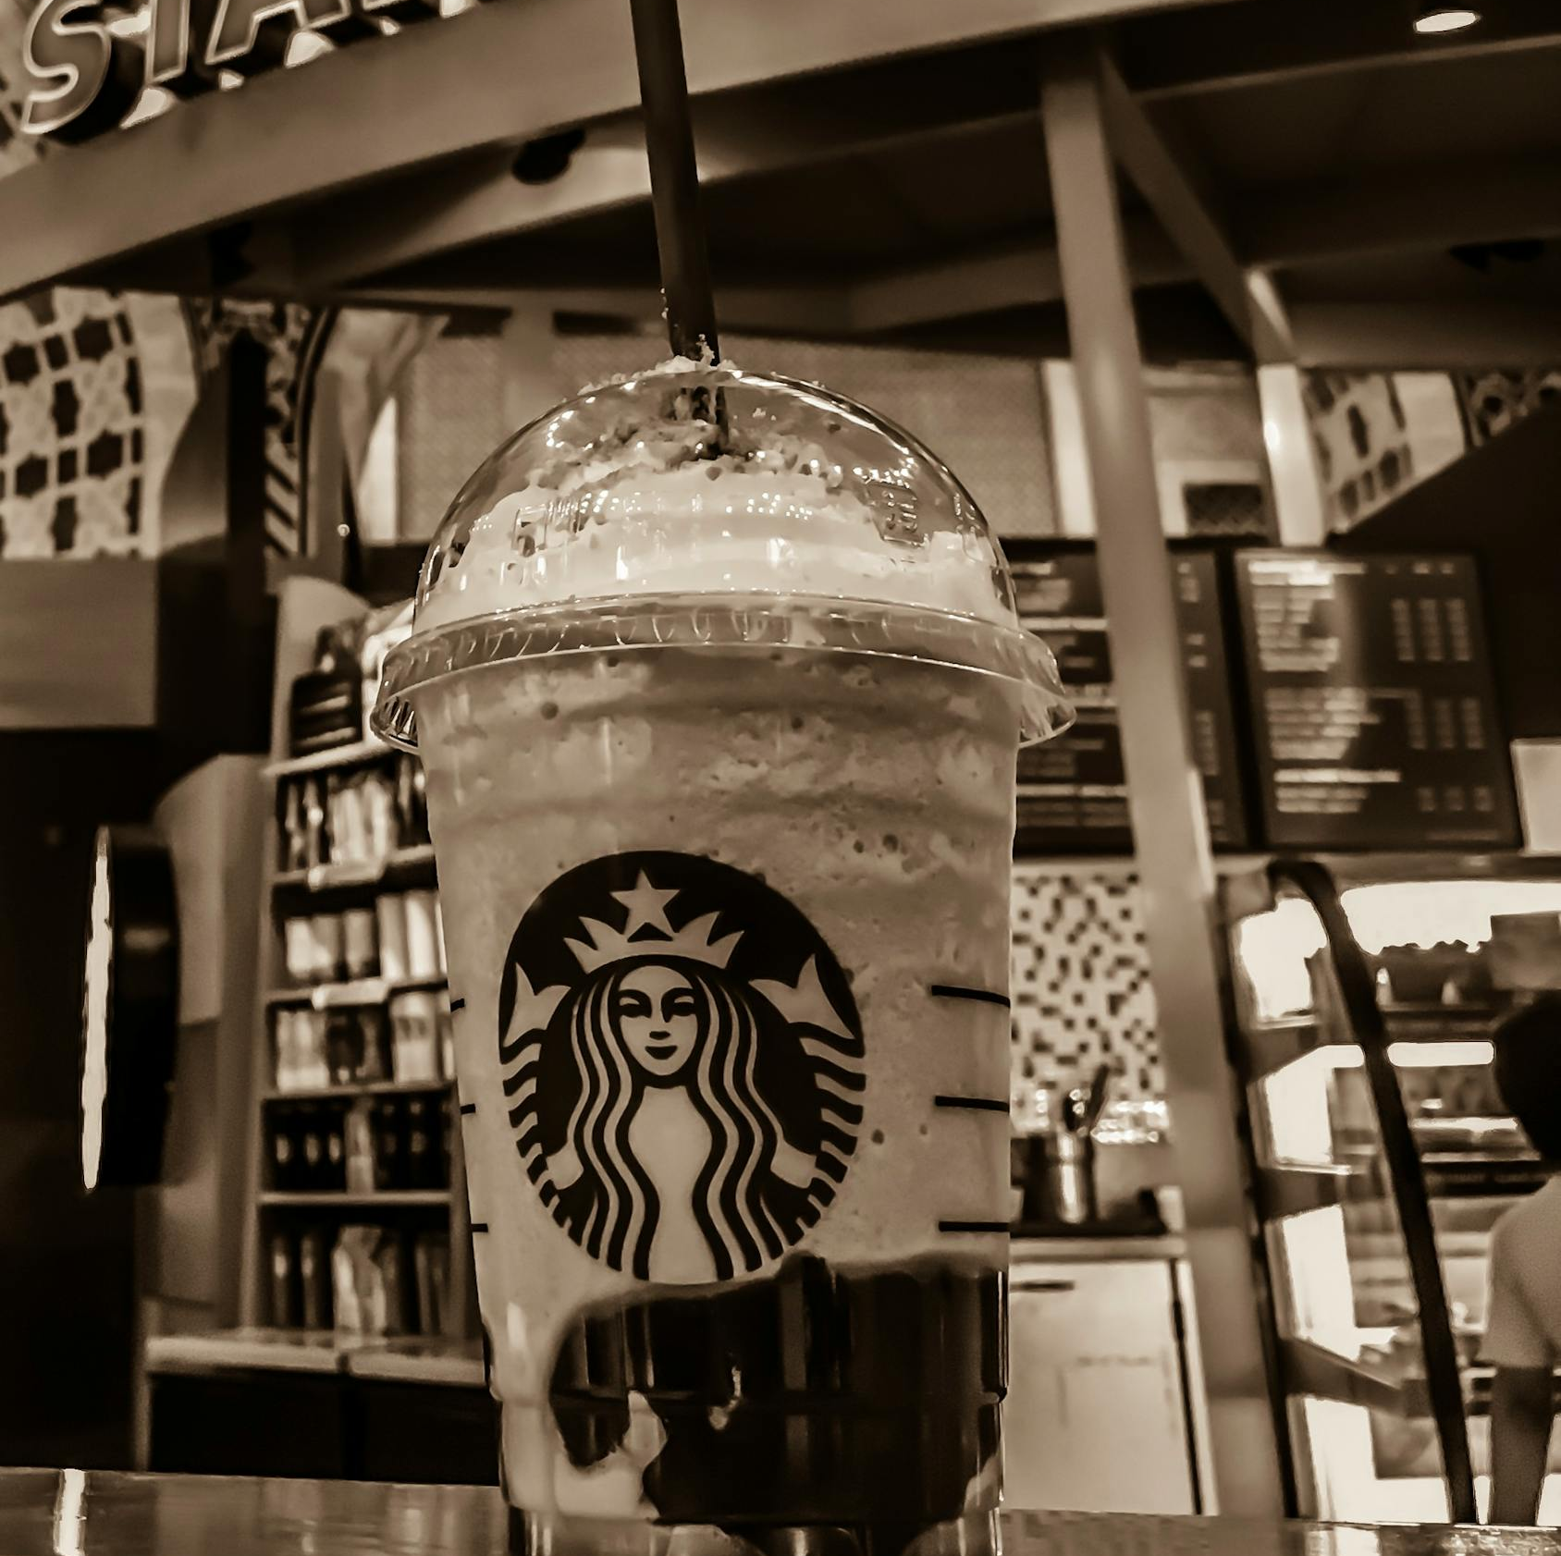
Thank you. Questions?

